Slide 1









Whiteboardmaths.com
7
2
1
5
© 2004 All rights reserved

Slide 2






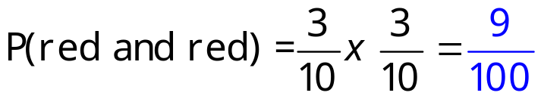

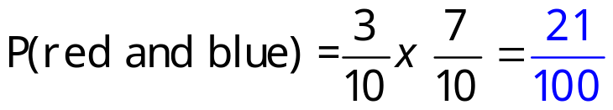
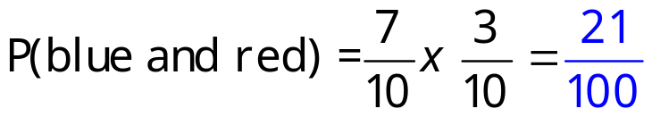
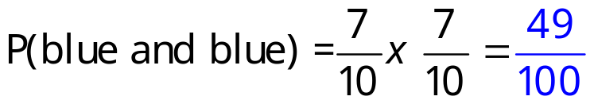
Independent
Probability (Tree Diagrams)
Tree diagrams can be used to help solve problems involving both dependent and independent events.
The following situation can be represented by a tree diagram.
Peter has ten coloured cubes in a bag. Three of the cubes are red and 7 are blue. He removes a cube at random from the bag and notes the colour before replacing it. He then chooses a second cube at random. Record the information in a tree diagram.
First Pick
Second Pick
red
red
blue
red
blue
blue

Slide 3

Characteristics
Probability (Tree Diagrams)
Characteristics of a tree diagram
First Event
Second Event
red
red
blue
red
blue
The probabilities for each outcome are shown along the arm of each branch and they sum to 1.
blue
Ends of first and second level branches show the different outcomes.
Probabilities are multiplied along each arm.

Slide 4


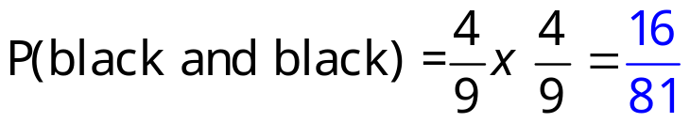

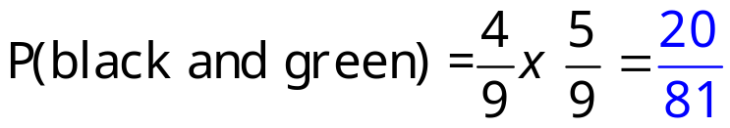
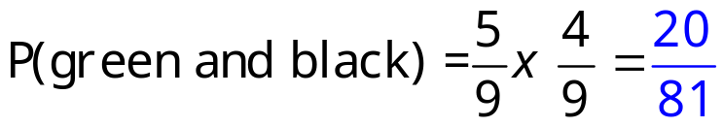
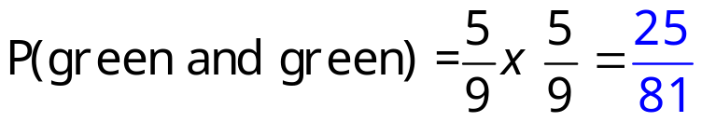
Q1 beads
Probability (Tree Diagrams)
Question 1 Rebecca has nine coloured beads in a bag. Four of the beads are black and the rest are green. She removes a bead at random from the bag and notes the colour before replacing it. She then chooses a second bead. (a) Draw a tree diagram showing all possible outcomes. (b) Calculate the probability that Rebecca chooses: (i) 2 green beads (ii) A black followed by a green bead.
First Pick
Second Pick
black
black
green
black
green
green

Slide 5


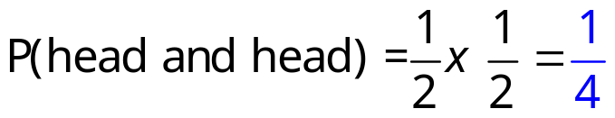
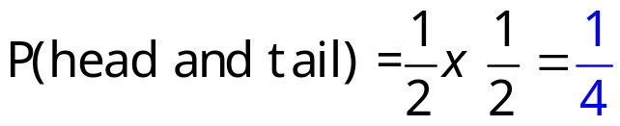
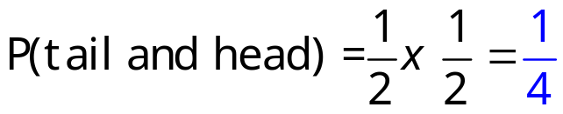
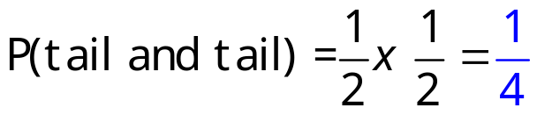
Q2 Coins
Probability (Tree Diagrams)
Question 2 Peter tosses two coins. (a) Draw a tree diagram to show all possible outcomes. (b) Use your tree diagram to find the probability of getting (i) 2 Heads (ii) A head or a tail in any order.
First Coin
Second Coin
head
head
tail
head
tail
tail
P(2 heads) = ¼
P(head and a tail or a tail and a head) = ½

Slide 6
Q3 Sports
Probability (Tree Diagrams)
Question 3 Peter and Becky run a race and play a tennis match. The probability that Peter wins the race is 0.4. The probability that Becky wins the tennis is 0.7. (a) Complete the tree diagram below. (b) Use your tree diagram to calculate (i) the probability that Peter wins both events. (ii) The probability that Becky loses the race but wins at tennis.
Race
Tennis
0.3
Peter Win
0.4 x 0.3 = 0.12
Peter Win
0.4
Becky Win
0.7
0.4 x 0.7 = 0.28
0.3
Peter Win
0.6 x 0.3 = 0.18
0.6
Becky Win
0.7
Becky Win
0.6 x 0.7 = 0.42
P(Win and Win) for Peter = 0.12
P(Lose and Win) for Becky = 0.28

Slide 7

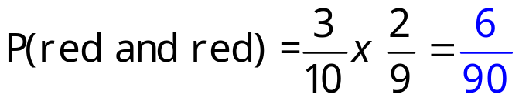

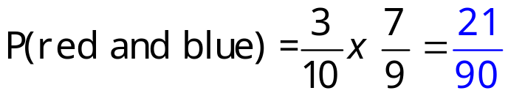

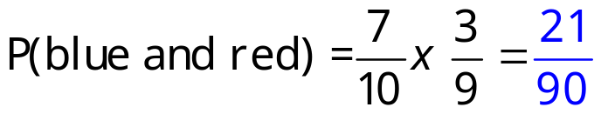

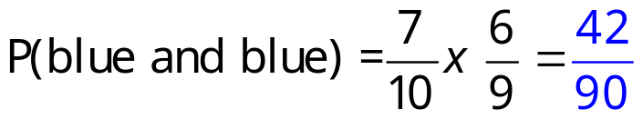
Dependent
Probability (Tree Diagrams)
Dependent Events
The following situation can be represented by a tree diagram.
Peter has ten coloured cubes in a bag. Three of the cubes are red and seven are blue. He removes a cube at random from the bag and notes the colour but does not replace it. He then chooses a second cube at random. Record the information in a tree diagram.
First Choice
Second Choice
red
red
blue
red
blue
blue

Slide 8

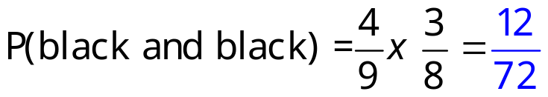

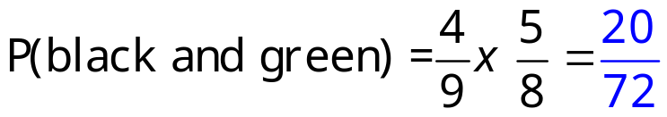

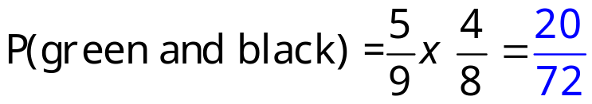
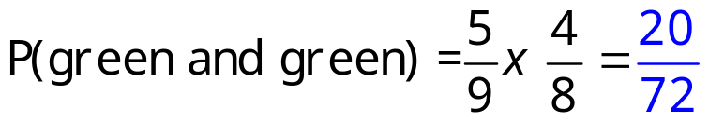
Q4 beads
Probability (Tree Diagrams)
Dependent Events
Question 4 Rebecca has nine coloured beads in a bag. Four of the beads are black and the rest are green. She removes a bead at random from the bag and does not replace it. She then chooses a second bead. (a) Draw a tree diagram showing all possible outcome (b) Calculate the probability that Rebecca chooses: (i) 2 green beads (ii) A black followed by a green bead.
First Choice
Second Choice
black
black
green
black
green
green

Slide 9


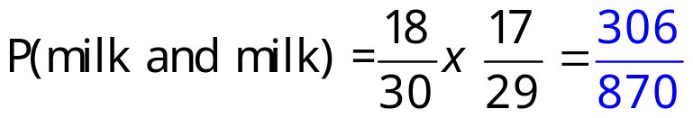


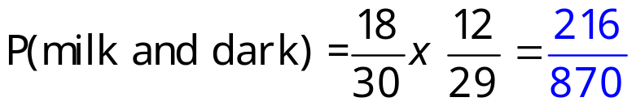

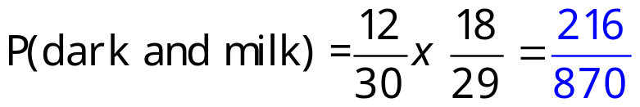


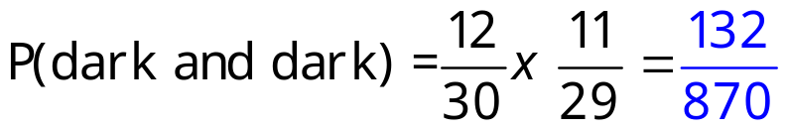
Q5 Chocolates
Probability (Tree Diagrams)
Dependent Events
Question 5 Lucy has a box of 30 chocolates. 18 are milk chocolate and the rest are dark chocolate. She takes a chocolate at random from the box and eats it. She then chooses a second. (a) Draw a tree diagram to show all the possible outcomes. (b) Calculate the probability that Lucy chooses: (i) 2 milk chocolates. (ii) A dark chocolate followed by a milk chocolate.
First Pick
Second Pick
Milk
Milk
Dark
Milk
Dark
Dark

Slide 10



3 Ind
Probability (Tree Diagrams)
2 Independent Events
First Pick
Second Pick
red
red
blue
yellow
red
blue
blue
yellow
red
yellow
blue
yellow

Slide 11
3 Ind/Blank
Probability (Tree Diagrams)
2 Independent Events
First Pick
Second Pick
red
red
blue
yellow
red
blue
blue
yellow
red
yellow
blue
yellow

Slide 12
3 Ind/Blank/2
Probability (Tree Diagrams)
2 Independent Events
First Event
Second Event

Slide 13





3 Dep
Probability (Tree Diagrams)
2 Dependent Events
First Event
Second Event
red
red
blue
yellow
red
blue
blue
yellow
red
yellow
blue
yellow

Slide 14
3 Dep/Blank
Probability (Tree Diagrams)
2 Dependent Events
First Event
Second Event
red
red
blue
yellow
red
blue
blue
yellow
red
yellow
blue
yellow

Slide 15
3 Dep/Blank/2
Probability (Tree Diagrams)
2 Dependent Events
First Choice
Second Choice
3 Dep/Blank

Slide 16
3 Ind/3 Select
Probability (Tree Diagrams)
First Choice
Second Choice
Third Choice
red
3 Independent Events. 2 Outcomes
blue
red
red
red
blue
blue
red
red
blue
blue
blue
red
blue

Slide 17
3 Ind/3 Select/Blank
Probability (Tree Diagrams)
First Choice
Second Choice
Third Choice
red
3 Independent Events. 2 outcomes
blue
red
red
red
blue
blue
red
red
blue
blue
blue
red
blue

Slide 18
3 Ind/3 Select/Blank2
Probability (Tree Diagrams)
First Choice
Second Choice
Third Choice
3 Independent Events. 2 outcomes

Slide 19




3 Dep/3 Select
Probability (Tree Diagrams)
First Choice
Second Choice
Third Choice
red
3 Dependent Events. 2 outcomes
blue
red
red
red
blue
blue
red
red
blue
blue
blue
red
blue

Slide 20
3 Dep/3 Select/Blank
Probability (Tree Diagrams)
First Choice
Second Choice
Third Choice
red
3 Dependent Events. 2 outcomes
blue
red
red
red
blue
blue
red
red
blue
blue
blue
red
3 Dep/3 Select
blue

Slide 21
3 Dep/3 Select/Blank2
Probability (Tree Diagrams)
First Choice
Second Choice
Third Choice
3 Dependent Events. 2 outcomes
3 Dep/3 Select

Slide 22
Worksheet 1
Probability (Tree Diagrams)
Tree diagrams can be used to help solve problems involving both dependent and independent events.
The following situation can be represented by a tree diagram.
Peter has ten coloured cubes in a bag. Three of the cubes are red and 7 are blue. He removes a cube at random from the bag and notes the colour before replacing it. He then chooses a second cube at random. Record the information in a tree diagram.

Slide 23
Worksheet 2

Slide 24
Worksheet 3

Slide 25
Worksheet 4

